Slide 1
Data Visualization & Storytelling
Saurabh Kango, Senior Manager - Business Analytics
https://www.linkedin.com/in/saurabhkango/

Slide 2
About me
Worked with LinkedIn as Insights Program Manager, Bangalore!
Developing Design skills was the best part when I worked at Airbnb.
Learned about been Scrapy at Mu Sigma
How I came to care about data visualization...
“ I was never good with drawing but I loved Colors”
“Storytelling and data visualization is Fun”

Slide 3
Why Data Visualization?
Visualizations are data stories made by transforming the data quantitatively, defining relations, patterns and creating interactive images.
Graphical or pictorial representation of data is Data visualization.
It enables executives, business leaders, reachers, decision-makers to see analytics presented visually, so they can grasp difficult concepts or identify new patterns.
Using tables or raw data, certain patterns, trends, and correlations might go unnoticed, and thus recognizing these patterns is easier with data visualization.

Slide 4
Benefits of Data Visualization:
Considering the impact that data has in the growth of the business ,here are a few benefits:
Helps to identify the latest trend to improve the product and increase the profits for business.
Data visualizations make big and small data easier for the human brain to understand,leading to better analysis.
Helps understanding the story-The human brain is not able to understand or even just imagine large amounts of numbers or text at once. It needs a visual representation to make sense of them and consequently translate raw data into tangible concepts.

Slide 5
Storytelling is more important than plotting complex graphs. ”

Slide 6

Remove to Improve: Less is More
Darkhorse Analytics

Slide 7
Agenda
External resources
Principles of Data Visualization
How to make good charts
Data Visualization & Storytelling

Slide 8
External Resources for Data Visualization
Guidelines & Sources of Inspiration
Quick Reads
Blogs
Academic Tomes
5 Data Storytelling Tips for Creating More Persuasive Charts and Graphs
Ten Simple Rules for Better Figures ( favorite academic paper)
Stephen Few (Perceptual Edge)
Darkhorse Analytics blog
Hans Rosling’s 2006 TED Talk [storytelling]
Edward Tufte (ironically, worst website ever)

Slide 9
Principles of Data Visualization
Decide on your message
Aesthetics matter
Communicate clearly

Slide 10
1. Message
“Signal must come first, even if your aim is primarily engagement”
Choose the right chart/graph for you message
Choose the right chart elements
Make sure your figure supports your message.

Slide 11
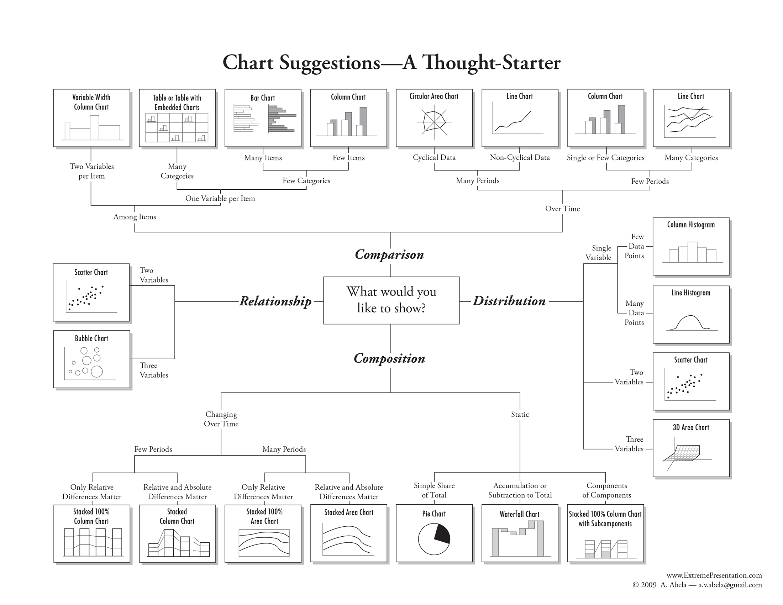
Choosing the Right Chart

Slide 12
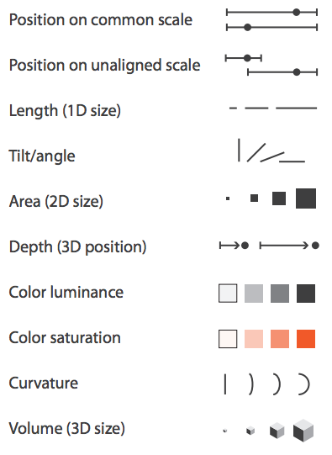
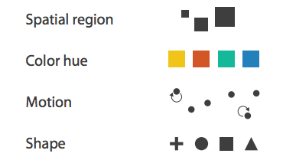
Choosing the Right Chart Element (Channel)
effective
Read more about color
effective
Adapted from Tamara Munzner. Visualization Analysis and Design

Slide 13
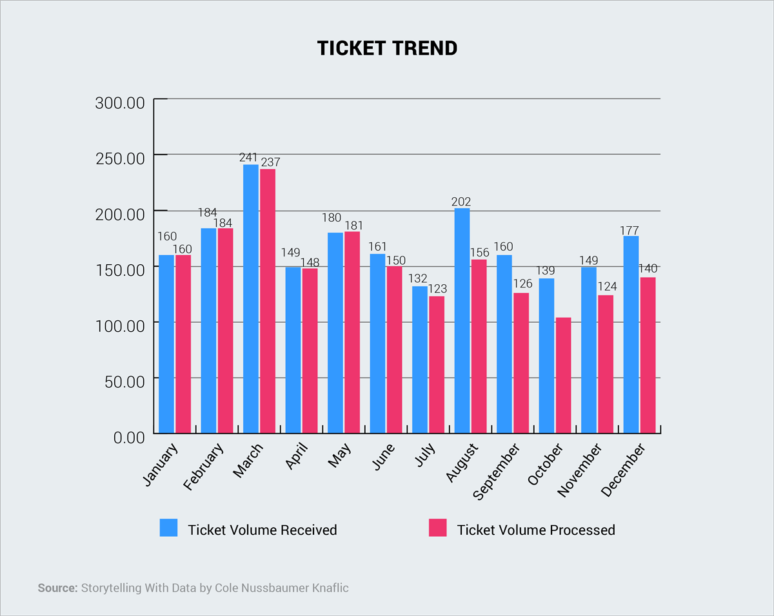
Choosing the Right Chart to Emphasize the Message
Making the case by emphasizing difference
5 Data Storytelling Tips for Creating More Persuasive Charts and Graphs

Slide 14
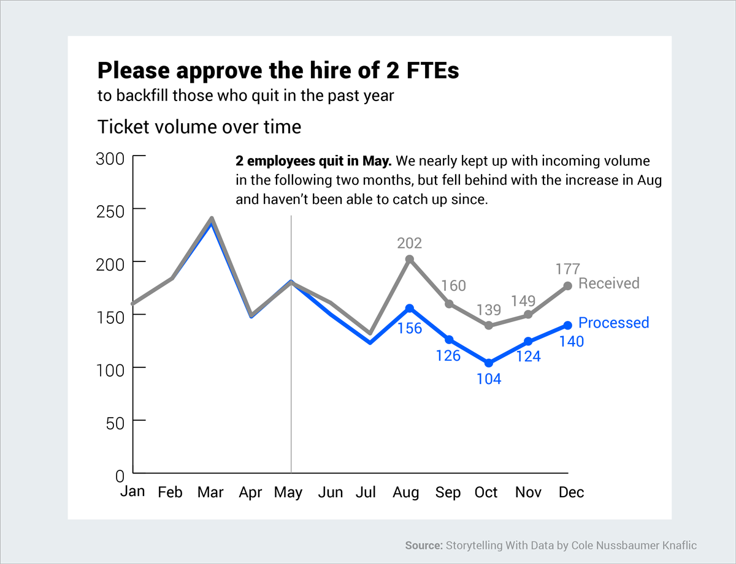
Choosing the Right Chart to Emphasize the Message
Making the case by emphasizing difference
5 Data Storytelling Tips for Creating More Persuasive Charts and Graphs

Slide 15
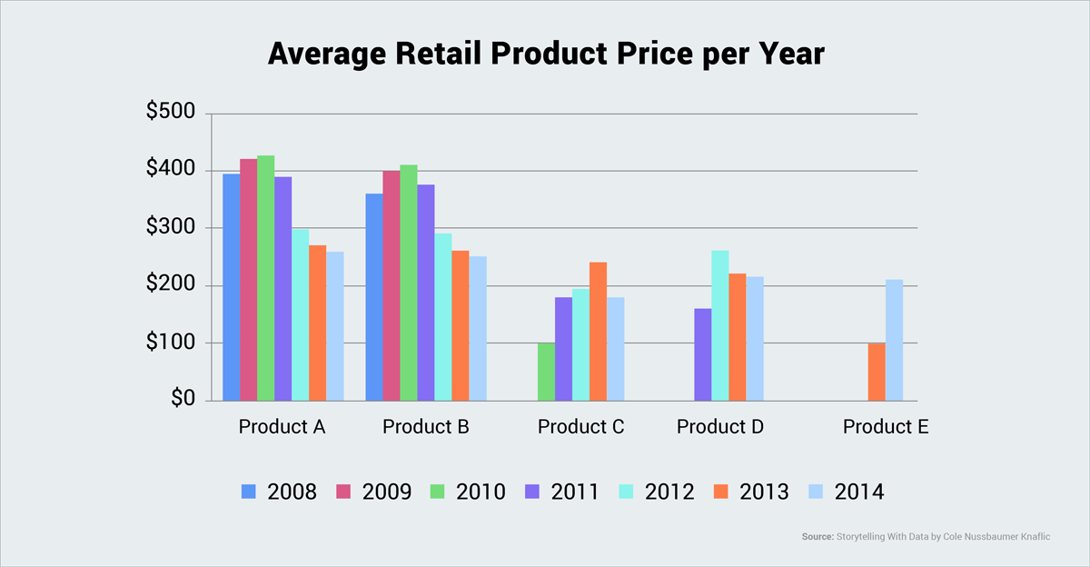
Choosing the Right Chart to Emphasize the Message
Making the case by emphasizing (converging) similarity
5 Data Storytelling Tips for Creating More Persuasive Charts and Graphs

Slide 16
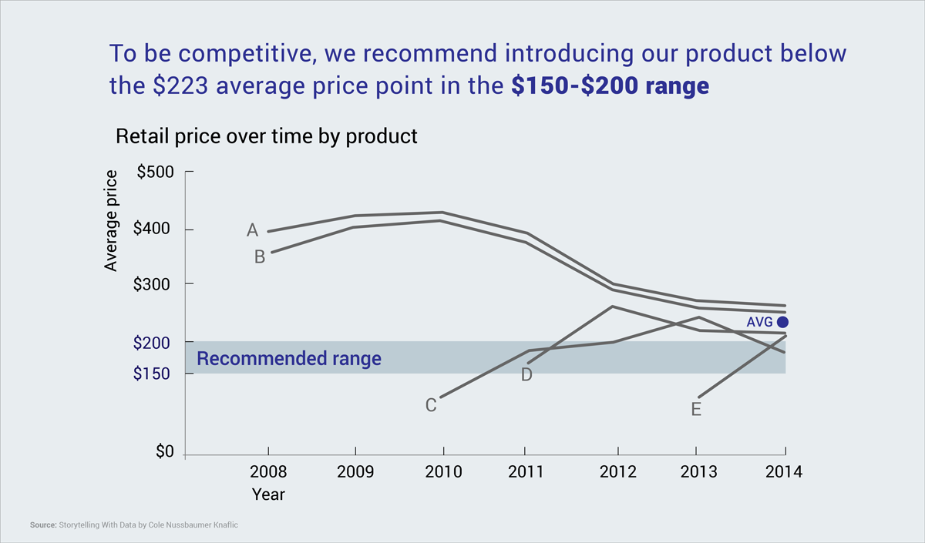
Choosing the Right Chart to Emphasize the Message
Making the case by emphasizing (converging) similarity
5 Data Storytelling Tips for Creating More Persuasive Charts and Graphs

Slide 17
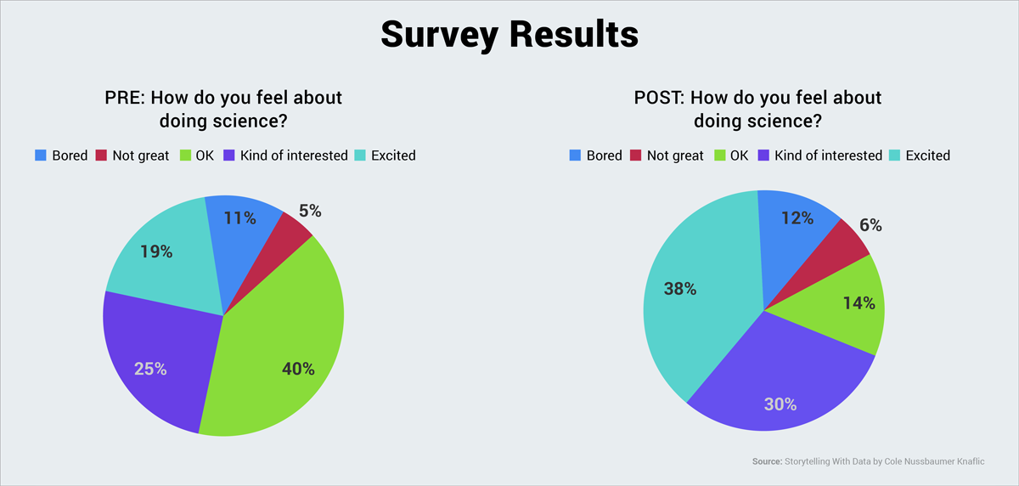
Choosing the Right Chart to Emphasize the Message
Making the case by emphasizing grouping the differences
5 Data Storytelling Tips for Creating More Persuasive Charts and Graphs

Slide 18
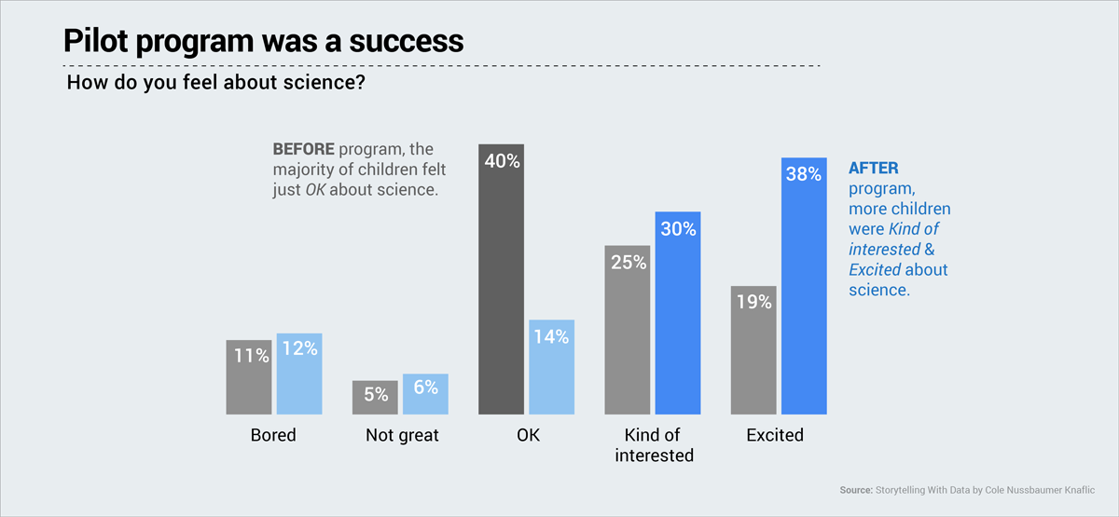
Choosing the Right Chart to Emphasize the Message
Making the case by emphasizing grouping the differences
5 Data Storytelling Tips for Creating More Persuasive Charts and Graphs

Slide 19
2. Aesthetics
Don’t trust the default settings
It’s not just about looking pretty; it’s about being easily interpretable.

Slide 20
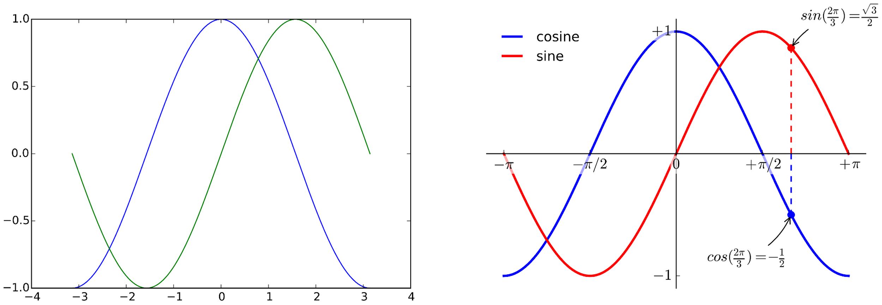
Don’t trust the default settings
Make it as easy as possible to understand your figure
Ten Simple Rules for Better Figures

Slide 21
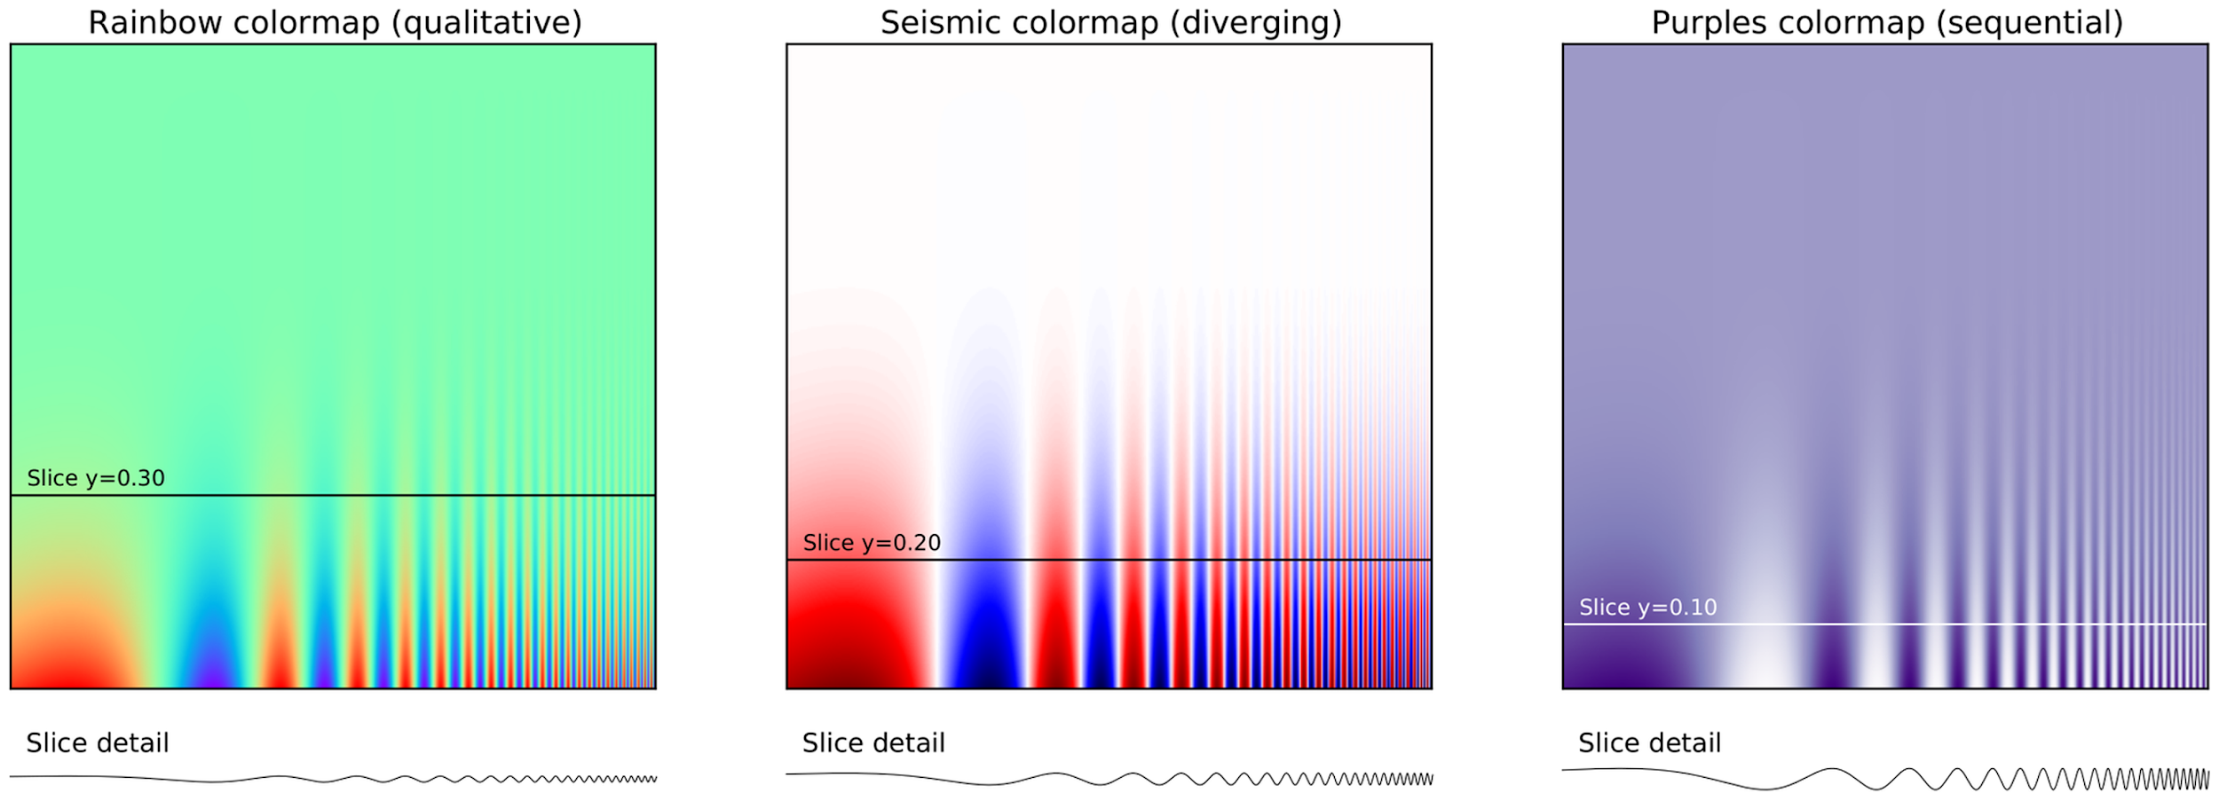
Don’t trust the default settings
Be mindful of how you use color!
Ten Simple Rules for Better Figures

Slide 22
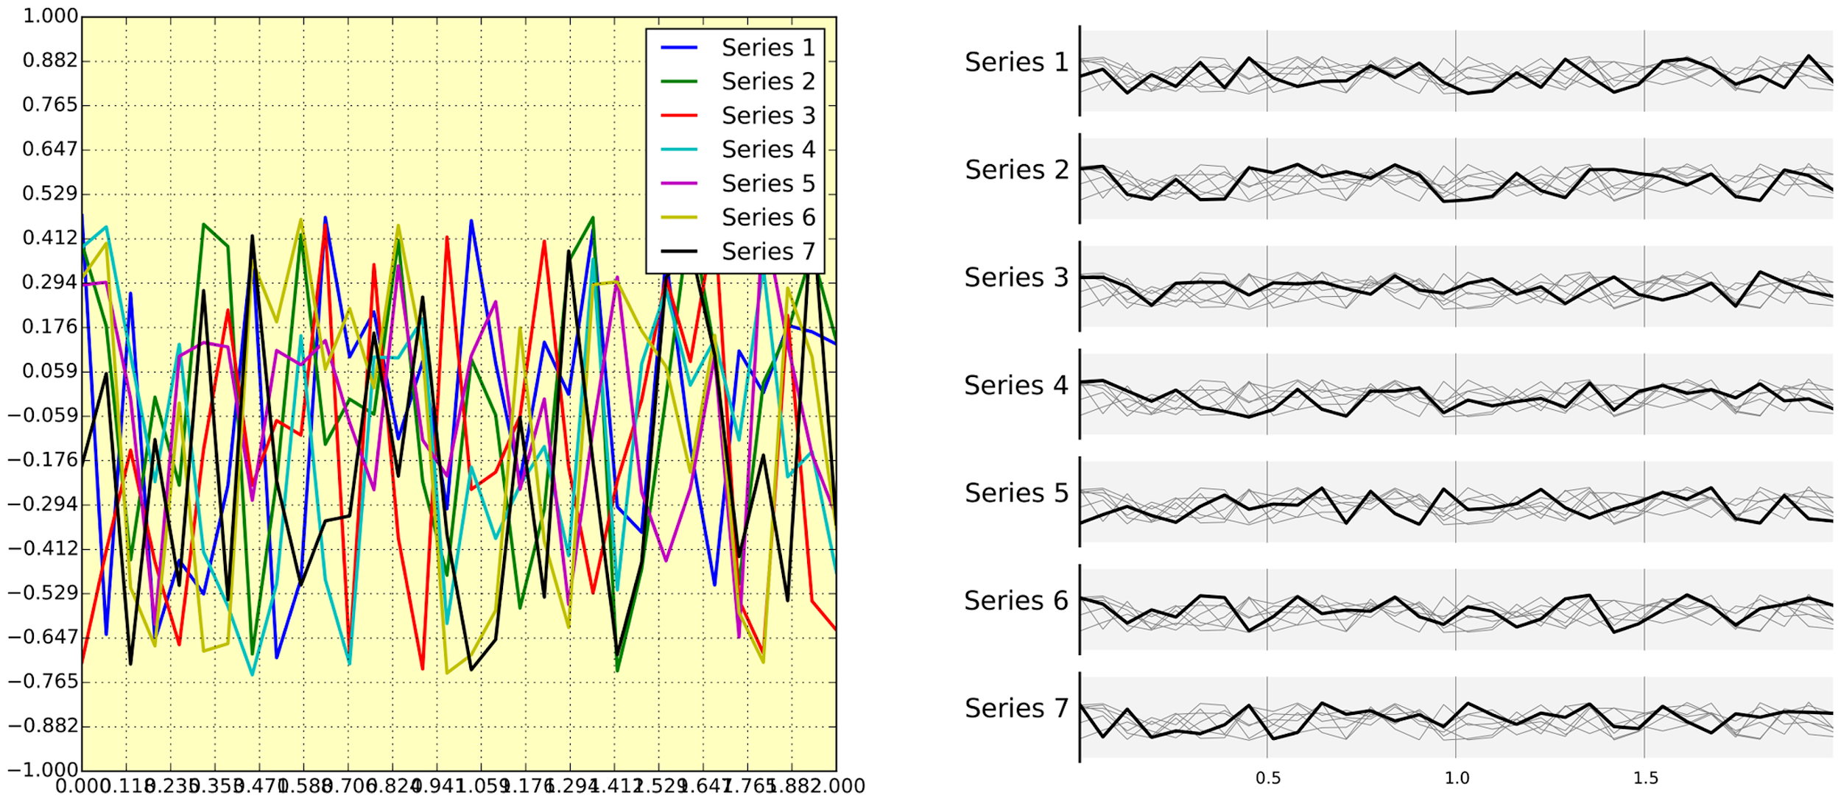
Don’t trust the default settings
Avoid chartjunk
Ten Simple Rules for Better Figures

Slide 23
3. Communicate Clearly
Know your audience & message
Label axes, include title & legend in a legible size & font.
Show control (baseline) data first and in the “neutral” (gray) color
X-axis should be the independent variable (time, category)
Scale things appropriately [try to avoid clipping the Y-axis…]
How to improve the defaults

Slide 24
Application of Principles
1. Message & Audience
3. Baseline neutral
4. Independent Variable
2. Labelled & Legible
5 Data Storytelling Tips for Creating More Persuasive Charts and Graphs

Slide 25
Application of Principles
1. Message & Audience
2. Labelled & Legible
3. Baseline neutral
4. Independent Variable
5 Data Storytelling Tips for Creating More Persuasive Charts and Graphs

Slide 26
Applications of Principles
1. Message & Audience
2. Labelled & Legible
3. Baseline neutral
4. Independent Variable
5 Data Storytelling Tips for Creating More Persuasive Charts and Graphs

Slide 27
Principles of Data Visualization
Decide on your message
Choose the right chart to make your point
Aesthetics matter
Don’t trust the default settings
Communicate clearly
Label & Make Legible

